Slide 1

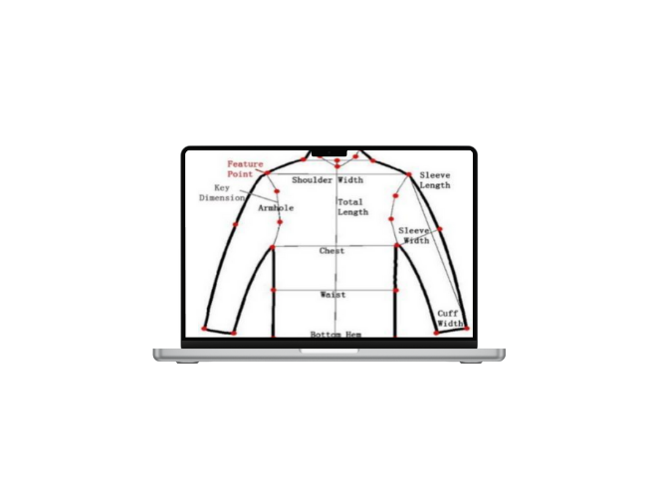
DEPARTMENT OF COMPUTER SCIENCE AND ENGINEERING(DATA SCIENCE)​
Major Project on
Automated Shirt Size Prediction Using Machine Learning and Image Processing
Under the Guidance of ​
Team : B1
Dr. Revathi Durgam
A. Venkatesh 225U1A6701
Pavan Kalyan 225U1A6733
Tharun 225U1A6743
P. Pavan Kumar 235U5A6705

Slide 2

ABSTRACT
The increasing demand for online clothing purchases has created a major challenge for customers in selecting the correct shirt size without physically trying the clothing. This project presents an intelligent Shirt Size Prediction System that accurately predicts a user’s shirt size using machine learning and human body measurement extraction.
The system uses an image uploaded by the user and automatically extracts key body measurements such as shoulder width, chest size, and waist size using Mediapipe pose estimation.
A user-friendly web interface is developed using Flask, allowing users to upload their full-body image, enter height, and instantly receive their predicted shirt size along with extracted measurements. The system provides quick, accurate, and consistent predictions, helping users avoid size-related issues while shopping online. This project showcases the effective integration of computer vision and machine learning to build a practical solution for real-world applications in fashion technology.

Slide 3
INTRODUCTION
Frontend
HTML5 – For creating the structure of the user interface.
CSS3 – For designing and styling the pages to make the interface clean and user-friendly.
JavaScript – For handling interactions and enhancing the usability of the web interface.
Bootstrap – For creating responsive and visually appealing UI components.
Backend
Machine Learning
Random Forest Classifier – Used for predicting the final shirt size based on extracted measurements.
XGBoost Classifier – Used to improve prediction accuracy through boosting.
Ensemble Averaging – Final size recommendation based on combined model outputs.
Flask – Lightweight web framework used to build the backend web application and API endpoints.
OpenCV – Used for handling uploaded images and preprocessing.
MediaPipe Pose – Used for extracting human pose keypoints for measurement calculation.

Slide 4
LITERATURE REVIEW
Paper Name | Technology Used | Key Features | Limitations
“Human Body Measurement Using Computer Vision Techniques” | Classical Computer Vision, Edge Detection | Detects body contours and extracts basic measurements from images | Not accurate for different lighting, pose variations, and clothing
“A Deep Learning Approach for Human Pose Estimation” | Deep Learning, CNN, Pose Estimation | Robust landmark detection using neural networks | Requires GPU, high computation, struggles with unusual poses
“Automatic Apparel Size Recommendation Using Machine Learning” | SVM, Random Forest | Predicts clothing size using body measurements and size charts | Accuracy drops if dataset is imbalanced or small
“A Framework for Online Fit Recommendation” | Decision Trees, Body Size Models | Match user measurement with size ranges from multiple brands | Limited performance for unique or borderline body types
“Pose-based Body Measurement Extraction Using MediaPipe” | MediaPipe BlazePose, Python | Accurate keypoint detection, lightweight, real-time estimation | Works less accurately with loose clothing or low-resolution images
“Hybrid Vision–ML Approach for Cloth Size Prediction” | Pose Estimation + ML (RF, XGBoost) | Combines pose extraction + ML classification for 95%+ accuracy | Needs careful calibration and height scaling
“Image-Based Anthropometric Measurement System” | Computer Vision + Height Calibration | Converts pixel distances to cm using height | Requires accurate height input; small errors propagate
“Deep Learning for Body Shape and Size Classification” | CNN, Feature Extraction | Learns body shape features directly from images | Requires large dataset; difficult to deploy on low-end devices

Slide 5
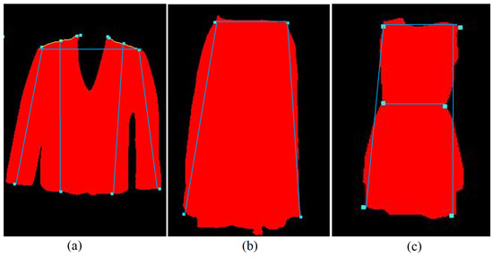
EXISTING SYSTEM
The existing system for clothing size selection mostly depends on manual methods. Users typically choose their shirt size based on trial rooms, measuring tapes, or approximate guessing. Online shopping platforms show standard size charts, but customers must compare their measurements manually with these charts. Since every brand uses different size standards, this often leads to confusion and incorrect selections.

Slide 6
LIMITATIONS OF EXISTING SYSTEM
No automation for extracting body measurements
Not accurate for different body types
Brand size variations are not handled
User depends on manual comparison
No AI-based recommendation
High chances of wrong size selection

Slide 7
PROPOSED SYSTEM
Automated body measurement extraction from image
Uses advanced pose estimation (MediaPipe)
Converts pixel distances into actual cm using user height
Integrated dataset from multiple sources
Trained ML model using Random Forest & XGBoost
95%+ accurate size prediction
Fast, user-friendly UI built with Flask
Supports multiple body types and brand variations

Slide 8
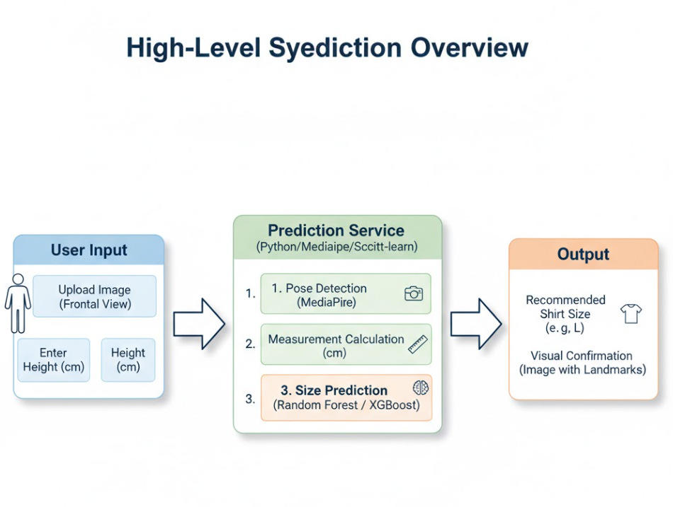
SYSTEM ARCHITECTURE
High-Level System Overview

Slide 9
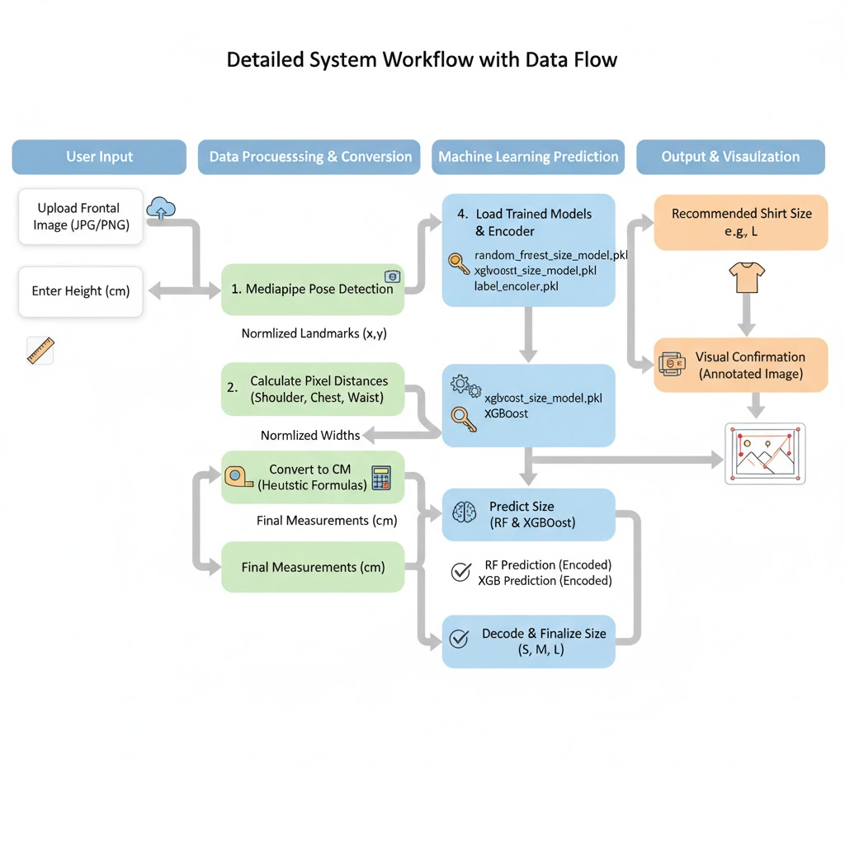
Detailed Workflow

Slide 10
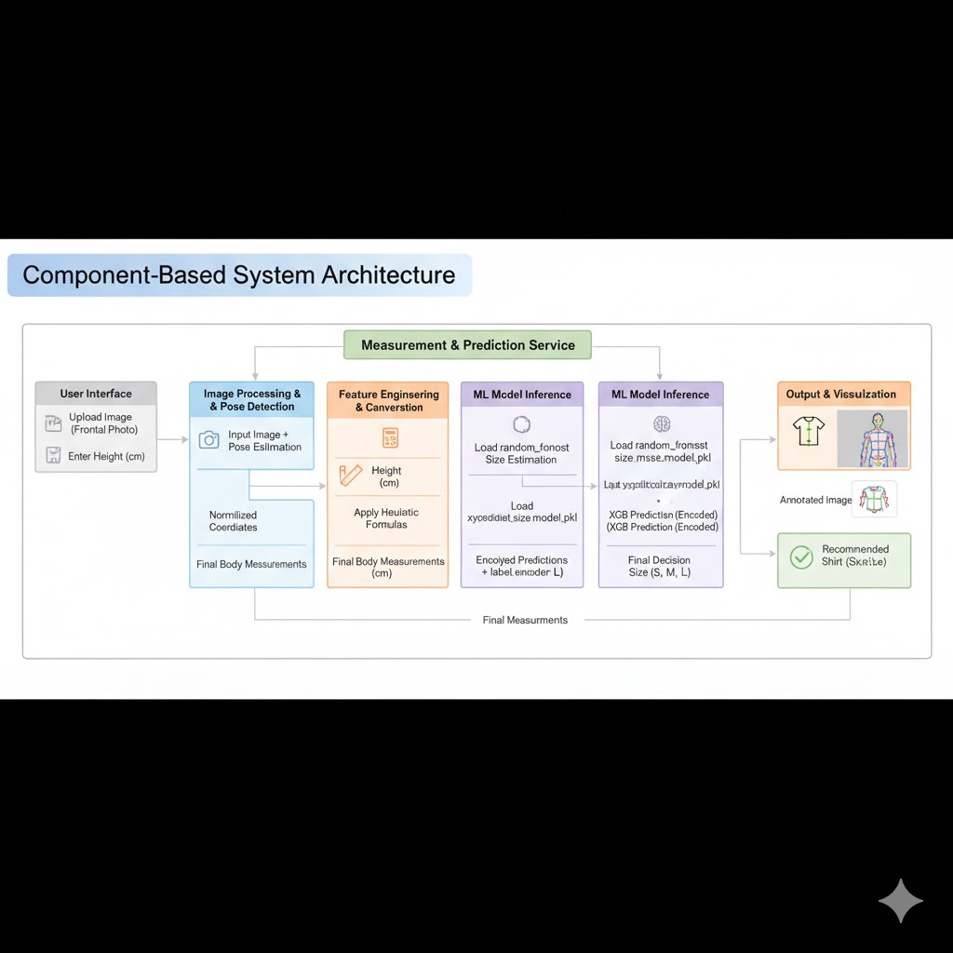
Component based Flow

Slide 11
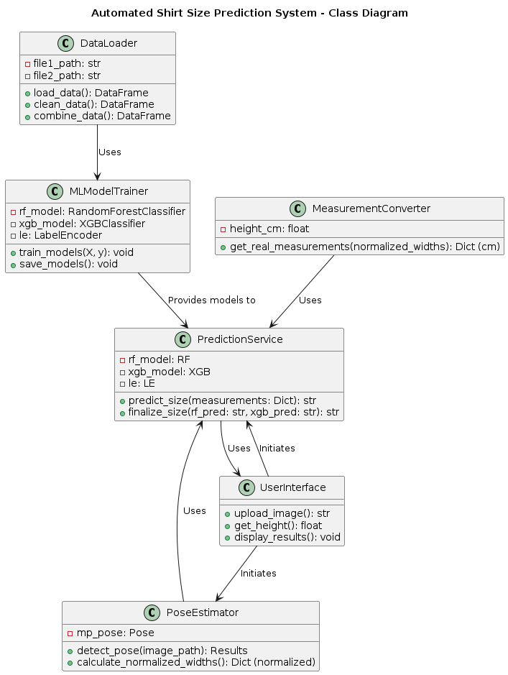
UML DIAGRAMS
Class Diagram

Slide 12
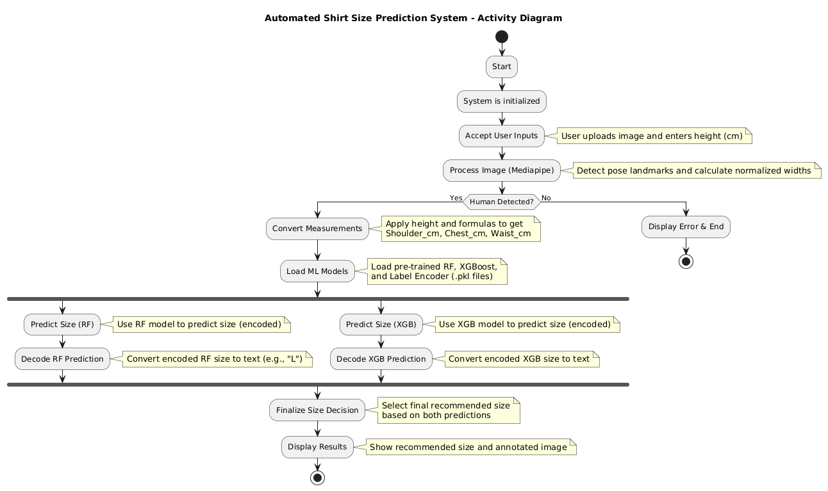
Activity Diagram

Slide 13
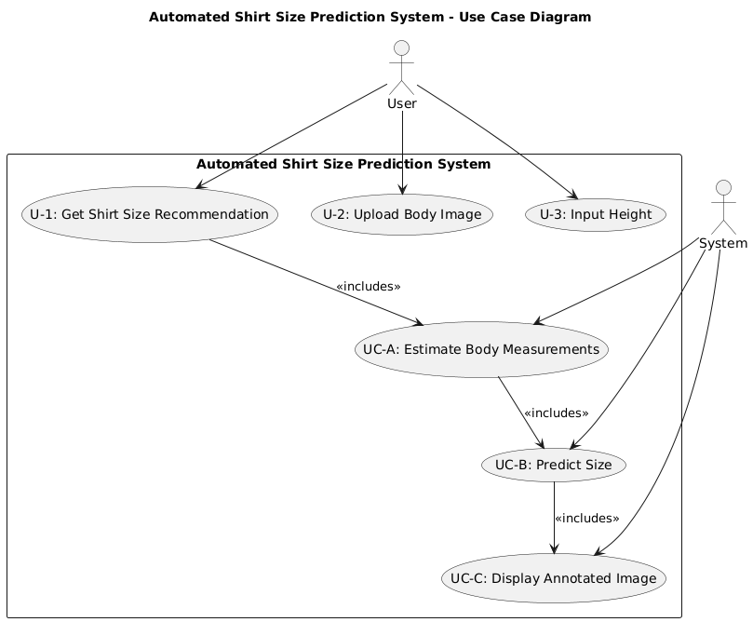
UseCase Diagram

Slide 14
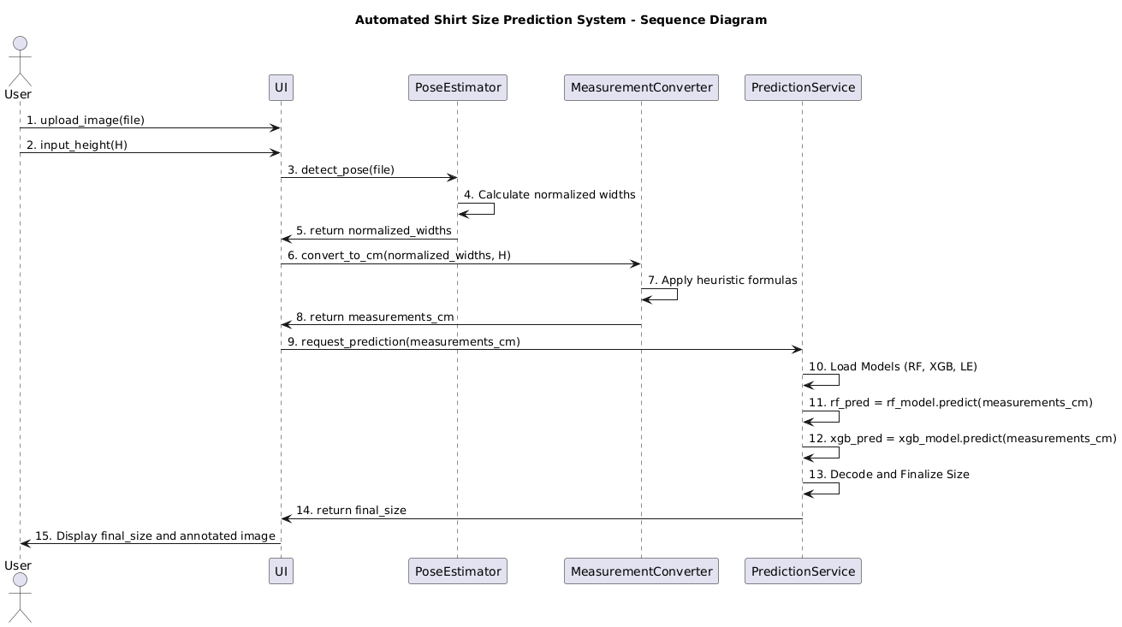
Sequence Diagram

Slide 15
MODULE DESCRIPTIONS
Image Input Module
Captures or uploads the user’s image for processing.
Acts as the starting point of the system.
Image Processing Module
Uses OpenCV and MediaPipe to detect key body landmarks.
Prepares the image for measurement extraction.
Feature Extraction Module
Calculates body measurements (like shoulder width, chest size, etc.) from detected landmarks.
Converts these values into numerical features for the model.
Machine Learning Module
Takes the extracted features as input.
Predicts the correct shirt size (S, M, L, XL, XXL) using models such as Random Forest or Logistic Regression.
Result Display Module
Shows the predicted shirt size to the user.
Provides a simple and user-friendly output interface.

Slide 16
CONCLUSION
The Shirt Size Prediction System provides a smart, automated solution for determining clothing sizes using a person’s photo. By leveraging OpenCV for image processing, MediaPipe for body measurement extraction, and ML models like Random Forest or Logistic Regression, it ensures accuracy and convenience. The system reduces manual measurement errors, saves time, and can be integrated into e-commerce or retail platforms to enhance user experience. It demonstrates how AI and computer vision can be applied to practical everyday problems effectively.

Slide 17


